Slide 1
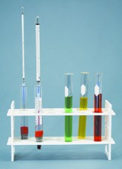
Thermochemistry:
Chapter 17

Slide 2
Thermochemisty
Thermochemistry
  Is the study of energy changes that occur during chemical reactions and changes in state
Two types of energy to consider:
  Chemical Potential Energy (PE)
    Energy Stored in the chemical bonds
  Kinetic Energy (KE)
    Energy of motion

Slide 3
Thermodynamics
2 Laws of Thermodynamics (simplified):
First Law of Thermodynamics: Energy can neither be created nor destroyed. It can, however, move from one place to another. (Law of Conservation of Energy)
Second Law of Thermodynamics: Energy always flows from a more concentrated place to a less concentrated place. (High energy to low energy; high temperature to low temperature)

Slide 4
Heat vs Temperature
The misconceptions….

Slide 5
Heat Energy vs Temperature
Wealth vs Dollar
Heat (Usually in Joules or KiloJoules or calories or Kilocalories)
  Is a form of energy that flows
  Always travels from warm areas to cool areas
    From high kinetic energy areas to low kinetic energy areas
Temperature (In Celsius or Kelvin)
  Is a measure of the average kinetic energy of particles
  As the average kinetic energy of the particles increases, the temperature increases
  Heat is not temperature! Temperature is not heat!
  Misconceptions about heat and temperature….

Slide 6
Heat vs. Temperature
Do not use the term “heat” if you mean temperature!
Do not use the term “temperature” if you mean heat!
Unit for temperature (T): °C
Units for heat (q):
  Joule (J) (1000 joules = 1 kilojoule)
  calorie (cal) (1000 calories = 1 kilocalorie)
Conversions:
  1 cal = 4.184 J

Slide 7
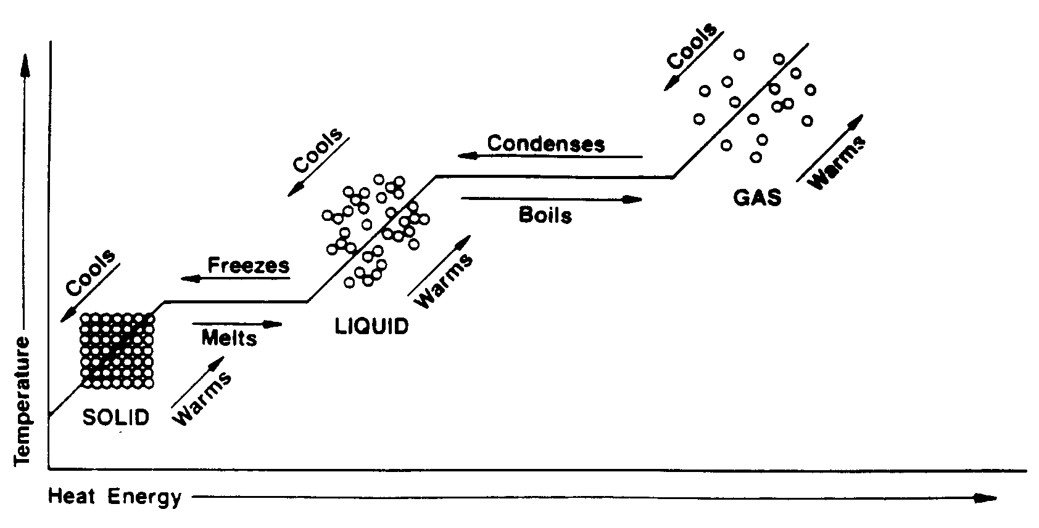
Energy: Heating/Cooling Curve
Shows the temperature and energy of a substance over time as it changes from a solid to a gas
To increase the temperature we must add energy.

Slide 8
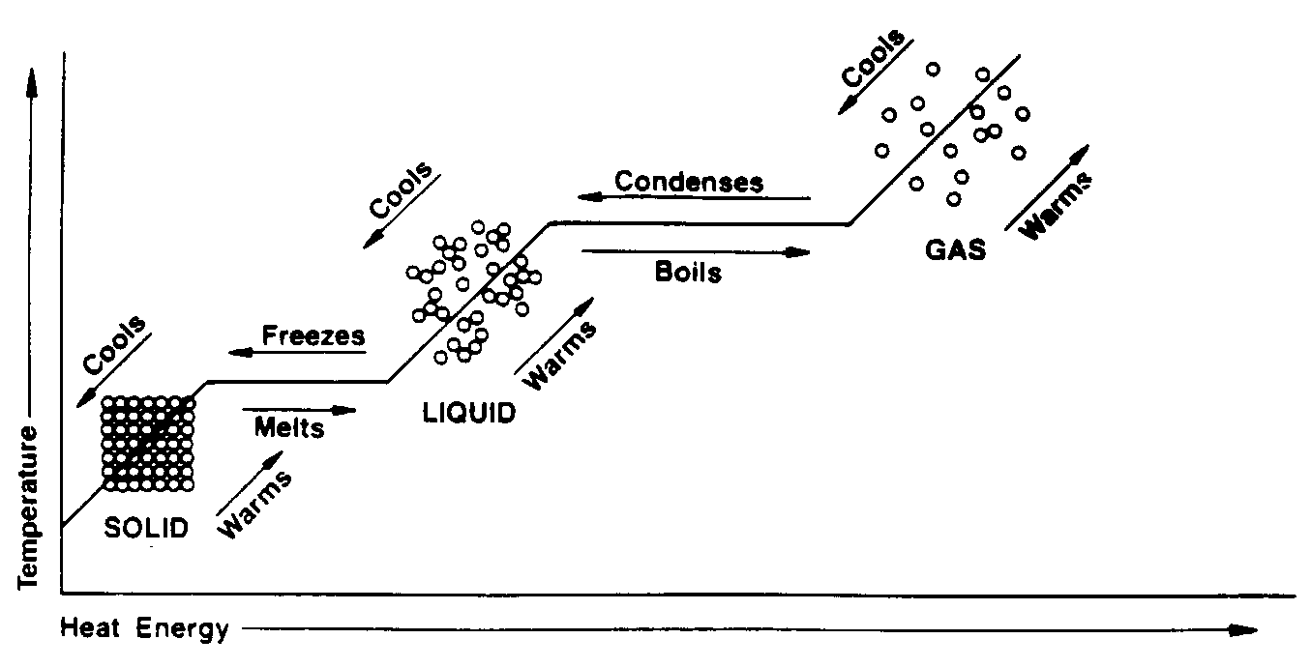
Phase Changes
Melting point
  Solid to liquid : No temperature change until all of the solid changes to a liquid
Freezing point
  Liquid to solid: No temperature change until all of the liquid changes to a solid
Melting point and freezing point are the SAME temperature!

Slide 9

Phase Changes
Melting point
  Solid to liquid : No temperature change until all of the solid changes to a liquid
Freezing point
  Liquid to solid: No temperature change until all of the liquid changes to a solid

Slide 10
Heat and Phase Changes
Exothermic
Endothermic
Condensation
Freezing
Deposition
Evaporation
Melting
Sublimation
What’s the Pattern Here?
Those changes that ‘spread’ molecules out take in heat; those changes that ‘condense’ molecules give off heat.
Does it take heat to do the process?

Slide 11
Heat Capacity(not as useful)
e
d
Temp.
c
b
a
Time
Endothermic: add heat
Exothermic: heat released
How much heat is needed to raise the temperature of a solid, liquid, or gas?
Heat Capacity is amount of heat needed to raise the temperature of something 1°C
Heat Capacity depends on:
  How much substance you have (mass)
  The chemical composition

Slide 12
Specific Heat (capacity)
q = m *⬇T * C
q = heat
m = mass
⬇T = change in temp.
Cp = specific heat
capacity
e
d
Temp.
c
b
a
Time
Specific heat capacity: is the amount of heat needed to raise the temperature of 1 gram of a substance 1°C
a: Cp_{Ice} = 2.1 J/g°C
c: Cp_{Water} = 4.18 J/g°C
e: Cp_{Water Vapor} = 1.7 J/g°C

Slide 13
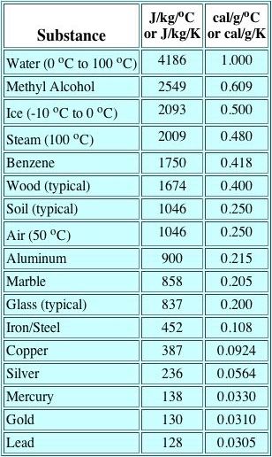
Specific Heat of Liquid Water

Slide 14
Specific Heat
Cp_{Ice} = 2.1 J/g°C
Cp_{Water} = 4.18 J/g°C
Cp_{Water Vapor} = 1.7 J/g°C
1000 J = 1 kJ
How much heat is required to change 10.0 g of water from 20.0°C to 50.0°C?
How much heat is required to change 10.0 g of ice from -30.0°C to -10.0°C?
1250 J OR 1.25kJ
420. J OR .420 kJ

Slide 15
Following the Flow of
H E A T
System
Exo-
therm
ic
  Exothermic reaction: the system releases heat to the surroundings
  Endothermic reaction: the system absorbs heat from the surroundings
Endo-
therm
ic
Surroundings

Slide 16
Calorimetry
Calorimetry: precise measurement of heat flow in or out of the system during a chemical or physical process
Two types of heat reactions:
  Exothermic reaction: the system releases heat to the surroundings
    The system loses heat
    The surroundings gain heat (and feel warmer)
  Endothermic reaction: the system absorbs heat from the surroundings
    The system gains heat
    The surroundings lose heat (and feel cooler)

Slide 17
Calorimetry
*****Heat GAINED = Heat LOST*****
If we can measure one, we have the other!
q = m *⬇T * C q = m *⬇T * C
Calculate heat gained by the water (all others known)
Heat gained by the water equals the heat lost by the metal
Calculate specific heat of the metal
(water) (metal)

Slide 18
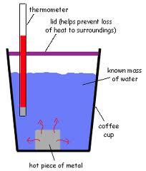
Calorimetry

Slide 19
Calorimetry
Unknown: specific heat of metal
Known: Specific heat of water, Masses of water & metals
Measured: change in temperature for water and zinc

Slide 20
Following the Flow of
H E A T
System
Exo-
therm
ic
  Exothermic reaction: the system releases heat to the surroundings
  Endothermic reaction: the system absorbs heat from the surroundings
Endo-
therm
ic
Surroundings

Slide 21
Heat of Fusion/Vaporization
Identify each phase and energy type (KE/PE) for sections a through e:
e
d
Temp.
c
b
a
Time
How much heat is needed to change a solid to a liquid, or a liquid to a gas?
The amount of heat needed depends on:
  How much substance you have
  The substance itself

Slide 22
Heat of Fusion/Vaporization
q = ⬇H*mol
q = heat
mol = moles
⬇H = enthalpy (heat content of a system, aka heat/mol)
e
d
Temp.
c
b
a
Time
Heat of fusion (melting): heat/mole absorbed to melt a substance Section b: ⬇H_{fus} = 6.01 KJ/mole
Heat of vaporization (boiling): heat/mole needed to vaporize a substance
Section d: ⬇H_{vap} = 40.7 KJ/mole
**No temp. change (flat line!)

Slide 23
Heat of Fusion
Heat of Fusion (melt): the amount of heat/mole absorbed to melt a solid substance
  ⬇H_{fus} = +6.01 KJ/mole
Heat of Solidification (freeze) : heat /mole lost when a liquid substance freezes (This is the SAME as Heat of Fusion, the negative sign only shows DIRECTION)
⬇H_{sol} = - 6.01 KJ/mole
Ice absorbs 6.01 kJ/mole to melt (+)
Water loses 6.01 kJ/mole to freeze (-)
How much heat is needed to melt 10.0 g of ice?
3.34 kJ = 3,340 J

Slide 24
Heat of Vaporization
Heat of Vaporization (boiling): the amount of heat/mole absorbed to vaporize a solid substance
  ⬇H_{vap} = 40.7 KJ/mole
Heat of Condensation: heat /mole lost when a liquid substance condenses(This is the SAME as heat of vaporization, the negative sign only shows DIRECTION)
⬇H_{cond} = - 40.7 KJ/mole
Water absorbs 40.7 kJ/mole to boil (+)
Steam loses 40.7 kJ/mole to condense (-)
How much heat is needed to evaporate 10.0 g of water?
22.6 kJ = 22,600J

Slide 25
Try it on your own…
Book page 524: #23, 24
Page 535: #55 (a & b only)
23) 144 kJ
24) .19 kJ
55a) 21.0 kJ
55b) 18 kJ

Slide 26
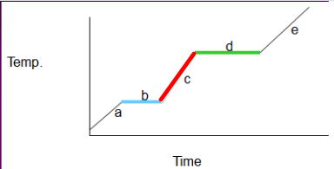
Putting it all together…
How much TOTAL heat is needed to melt 10.0 g of water, heat it until boiling, and then vaporize all 10.0 g of water?
This question requires multiple parts. We are going to identify those parts, then add them all together!

Slide 27
Putting it all together…
How much TOTAL heat is needed to melt 10.0 g of water, heat it until boiling, and then vaporize all 10.0 g of water?
Melting water uses what equation?(b)
Heating water uses what equation?(c)
Boiling water uses what equation?(d)

Slide 28
Putting it all together…
How much TOTAL heat is needed to melt 10.0 g of water, heat it until boiling, and then vaporize all 10.0 g of water?
q = ⬇H *mol
q =m * c* ⬇ T
q = ⬇ H * mol

Slide 29
Putting it all together…
How much TOTAL heat is needed to melt 10.0 g of water, heat it until boiling, and then vaporize all 10.0 g of water?
Knowns: 10.0g (convert to moles!) & 6.01kJ/mol
Knowns: 10.0g, change in T, & 4.18j/gºC
Knowns: 10.0g (convert to moles!) & 40.7 kJ/mol

Slide 30
Putting it all together…
How much TOTAL heat is needed to melt 10.0 g of water, heat it until boiling, and then vaporize all 10.0 g of water?
Calculate:
3.34 kJ
Calculate:
4180J
Calculate:
22.6kJ
Add up**:
30.12kJ or 30,120J
**You must make sure all energies are in the same unit! (1000J = 1kJ)***

Slide 31
Thermochemical Calculations
Things to remember
Use the appropriate equations for the appropriate parts of the problem
Make sure to use the appropriate specific heat values (such as for water vapor)
When adding up the energies, be sure to make all of the units the same

Slide 32
Practice on your own…
How much heat is required to raise the temperature of 25.0g of water from 15.0ºC to 135ºC? (Hint: think about if you will move through a phase change AND what Cp value(s) you will use!)

Slide 33
How much heat is required to raise the temperature of 25.0g of water from 15.0ºC to 135ºC?
e
d
Temp.
c
b
a
Time

Slide 34
Practice on your own…
How much heat is required to raise the temperature of 25.0g of water from 15.0ºC to 135ºC? (Hint: think about if you will move through a phase change AND what Cp value(s) you will use!)
8880 J
56.5 kJ
1490 J
66.9 kJ

Slide 35
Heat of “Reaction”
Thermochemical Equation
  Contains the enthalpy (heat) change when a chemical reaction takes place
  Can be written 2 ways:
  CaO_{(s)} + H₂O_{(l)} → Ca(OH)_{2 (s)} + 65.2 KJ (exothermic)
  or
  CaO_{(s)} + H₂O_{(l)} → Ca(OH)_{2 (s)} ∆H = - 65.2 KJ
  **The system is GIVING OFF or GIVING AWAY 65.3KJ, so the change to the system is -65.2KJ!!!!

Slide 36
Heat of “Reaction”
Practice Problem
Thermochemical Equation
  CaO_{(s)} + H₂O_{(l)} → Ca(OH)_{2 (s)} + 65.2 KJ (exothermic)
  or
  CaO_{(s)} + H₂O_{(l)} → Ca(OH)_{2 ( s)} ∆H = - 65.2 KJ
  Calculate the amount of heat (in kJ) released when 2.53 moles of CaO react.
  Calculate the amount of moles of water needed to produce 86.9kJ of energy.
164 kJ
1.33 mol

Slide 37
Heat of “Reaction”
Practice Problem
Thermochemical Equation
  2 NaHCO₃ + 129kJ → Na₂CO₃ + H₂O + CO₂
  Rewrite this reaction in the other format
  Calculate the amount of heat required to decompose 2.24 mol of NaHCO₃
  2 NaHCO₃ → Na₂CO₃ + H₂O + CO₂ ∆H = 129kJ
144 kJ

Slide 38
Heat of “Reaction”
Review
(ENDOTHERMIC)
AB + XY + Energy → AY + XB
AB + XY → AY + XB ∆H = + energy
(EXOTHERMIC)
AB + XY → AY + XB + Energy
AB + XY → AY + XB ∆H = - energy
**Energy can be used is mole ratio calculations**

Slide 39
Heat of Combustion
Heat of combustion (similar to heat of reaction):
  Is the heat of reaction produced from burning 1 mole of a substance
Combustion of natural gas (methane)
CH₄ + 2O₂ → CO₂ + 2H₂O + 890KJ
or
CH₄ + 2O₂ → CO₂ + 2H₂O ∆H = - 890KJ
Combustion of glucose
C₆H₁₂O₆ + 6O₂ → 6CO₂ + 6H₂O + 2808KJ

Slide 40
Heat of Solution (p. 525)
Heat of solution(similar to heat of reaction)
  Is the heat produced or absorbed during the formation of a solution
    The enthalpy change caused by dissolving one mole of a substance is the molar heat of solution (⬇H_{sol})
    **This works just like heat of reaction problems**

Slide 41
Heat of Solution
Exothermic reaction
  Produces heat
  Heat exits the calorimeter (exothermic)
  Is a negative number (products have less energy than the reactants)
NaOH_{(s)} → Na⁺_{(aq)} + OH⁻(aq)
∆H_{(sol)} = – 445.1KJ/mol
The reaction is giving off 445.1 KJ/mol
- J

Slide 42
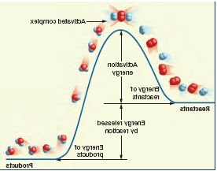
Heat of Solution
Endothermic reaction
  Requires heat energy from the environment to get reaction to run
  Heat enters the calorimeter (endothermic)
  Is a positive number: products have more energy than reactants
NH₄NO_{3 (s)} → NH₄⁺_{(aq)} + NO₃⁻_{(aq)}
∆H_{(sol)} = ⁺ 25.7 KJ/mol
The reaction is taking in 25.7 KJ/mol
Products
Energy absorbed by reaction
+J
Reactants

Slide 43
Standard Heats of Formation
Standard Heat of Formation (∆H_{f}⁰)
  ∆H_{f}⁰ is the change in enthalpy (heat) that occurs when 1 mole of a compound is formed from its elements at “standard state” (25ºC and 101.3 KPa)
  Can be used to calculate ∆H⁰ (standard heat of reaction)
  Note: ∆H_{rxn} is heat of reaction, but may not be standard state (25ºC and 101.3 KPa)
Values for ∆H_{f}⁰ H(are given, except …)
  ∆H_{f}⁰ of a free element in its standard state = 0
    All diatomic molecules (H₂, N₂, O₂, etc.)
    Elements (Fe, white P, and graphite C)

Slide 44
Standard Heats of Formation
Table 17.4
(on page 530 in book)

Slide 45
Calculating Heat of Formation
Standard Heat of Formation (∆H_{f}⁰)
  Is the difference between all of the standard heats of formation of the reactants & products
  Σ is the mathematical symbol meaning “the sum of”, and m and n are the coefficients of the substances in the chemical equation.

Slide 46
Calculating Heat of Formation
Standard Heat of Formation (∆H_{f}⁰)
Example:
  Find the standard heat of formation for:
  2CO_{(g)} + O_{2(g)} → 2CO_{2(g)}
  2(-110.5 KJ/mol) + 0 KJ/mol → 2(-393.5KJ/mol)
  ∆H⁰ = [-787.0 KJ] – [ -221.0 KJ + 0 KJ] = -566 KJ
  [see ∆H_{f}⁰ Table 17.4 on page 530 in book]

Slide 47
Practice Problem
What is the standard heat of reaction (∆H⁰) for the decomposition of hydrogen peroxide? (products are water vapor and oxygen gas)

Slide 48
Given Variables & Equations
∆H_{f}⁰ (standard heat of formation
  ∆H⁰ (standard heat of reaction)
  ∆H OR ∆H_{rxn} (heat of reaction)
    (no equation, just coefficients & stoichiometry)
  ⬇H_{sol} (heat of solution)
  ⬇H_{vap/fus}(heat of vaporization/fusion)
    q = ⬇H * mol
      q(heat); mol (# of moles)
  Cp (specific heat; liquid water = 4.18J/gºC)
    q = m *⬇T * Cp
        q (heat); m (mass, in grams); ⬇ T(change in temp);

Slide 49
YOU DO NOT NEED TO KNOW HESS’S LAW

Slide 50
Heat of Reaction: Hess’s Law
Sometimes a chemical reaction may involve a few steps.
  The reactants form products that also react, which produce new products
  Each step may either:
    Produce heat, or
    Absorb heat from the environment

Slide 51
Hess’s Law
Hess’s Law states that:
  If a chemical reaction is carried out in a series of steps, ⬇H for the reaction will be equal to the sum of the enthalpy changes for the individual steps
    ∑ ⬇H = ⬇H₁ + ⬇H₂ + ⬇H₃, etc.
  The total enthalpy of a reaction is independent of the reaction pathway.

Slide 52
Hess’s Law: Solving Problems
Rules for using Hess’s law in solving problems
  Make sure to rearrange the given equations so that reactants and products are on the appropriate sides of the arrows.
  If you reverse equations, you must also reverse the sign of ΔH (i.e., if positive, change to negative)
  Balance the equation. Then, if you multiply equations to obtain a correct coefficient, you must also multiply the ΔH by this coefficient.

Slide 53
Practice Problems
Find the ΔH for this overall reaction: N₂O₄(g) → 2NO₂(g) q=?
You are given the following equations:
2NO₂(g) → N₂(g) + 2O₂(g) q = -95 kJ
N₂(g) + 2O₂(g) → N₂O₄(g) q = 13 kJ

Slide 54
Practice Problems
Find the ΔH for this overall reaction:
P₄ + 10Cl₂ → 4PCl₅ q=?
Given the following equations
4PCl₃ → P₄ + 6Cl₂ q = 1518 kJ
PCl₅ → PCl₃ + Cl₂ q = 155 kJ

Slide 55
Practice Problems
Find the ΔH for this overall reaction:
2H₃BO₃ → B₂O₃ + 3H₂O
Given the following equations
H₃BO₃ → HBO₂ + H₂O q = -0.02 kJ
H₂B₄O₇ + H₂O → 4HBO₂ q = -11.3 kJ
H₂B₄O₇ → 2B₂O₃ + H₂O q = 17.5 kJ

